Slide 1

The GitHub map
A
Z
Ali Karooni & Lucas Bergeron
Notes:
The GitHub map from A to Z

Slide 2
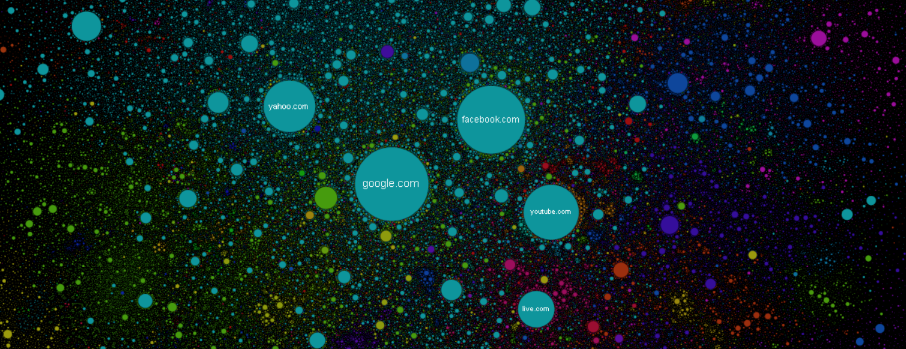
The internet map
Y
X
Notes:
Inspired from the internet map : https://internet-map.net/
There is no X or Y axis but an algorithme using attraction and repulsion,

Slide 3
Nodes & Edges
Repo B
User
B
User(s)
Repo(s)
Commits
Issues
Comments
Forks
…
Commits
Issues
Comments
Forks
…
Repo A
User A
Notes:
Two posibilities : Repo to Repo | User to User
The connection between every nodes is a user or a repo
The link between users and repo are commits, issues, comments, forks, ….

Slide 4
The graph
G
Y
A
L
M
H
D
I
F
E
J
C
B
Z
K
X
Notes:
The final graph could look like this ! But what about the axis ? Do we really need it ?

Slide 5
The axis
Y
Contributions
Good comment
Nb issues
Commit velocity
Nb issues
Nb of lines
Average time to close an issue
Age
Z
X
Notes:
To make this graph usefull, we have to find interesting X, Y and Z axis variables.
We have a lot of different possibilities for each axis : What if we could choose the variable we want for each axis ?

Slide 6
The database
User_contributs_to_Repo
User
Repo
uId
Z
rId
Y
uId
rId
X
Z
?
X
Y
?
?
?
?
?
Notes:
Here is the database we will build
To make this graph usefull, we have to find interesting X, Y and Z axis variables.

Slide 7

The dataset
Commits
Files
Contents
Licences
Repos
2,8 Millions repos
37 Gb
+
Notes:
We have found an interresting dataset on kaggle. This dataset is not enought complete for us : There is no issues and forks table,
However, mixed with a web scraping library, we could have acces to everything we need,
37 Gb is a lot, but we will not download everything. Actually, we can directly do some queries using the BigQuery library,

Slide 8
Thank you !
A
Z
Ali Karooni & Lucas Bergeron
Notes:
Thanks a lot for your attention, from A to Z ;)

